Slide 1
Threat models and
threat identifying methodologies
Lecture 2

Slide 2
Covered in this lecture:
1. Threats and vulnerabilities identification.
2. Vulnerability lifecycle.
3. Exploits.
4. Cyber Kill Chain.
5. STRIDE model.
6. Types of attacks
7. Threat Landscape

Slide 3
Vulnerability and exploit
Vulnerabilities are weaknesses leveraged by adversaries to compromise the confidentiality, availability or integrity of a resource; such weaknesses may result from design choices
Vulnerability refers to the inability (of a system or a unit) to withstand the effects of a hostile environment
Exploit is a piece of software, a chunk of data, or a sequence of commands that takes advantage of a bug or vulnerability to cause unintended or unanticipated behavior to occur on computer software, hardware, or something electronic.

Slide 4
Threat
An event, the occurrence of which could have an undesirable impact on the well-being of an asset.
Threat is a potential negative action or event facilitated by a vulnerability that results in an unwanted impact to a computer system or application
Any circumstances or event that has the potential to cause harm to a system or network. That means, that even the existence of an (unknown) vulnerability implies a threat by definition.

Slide 5
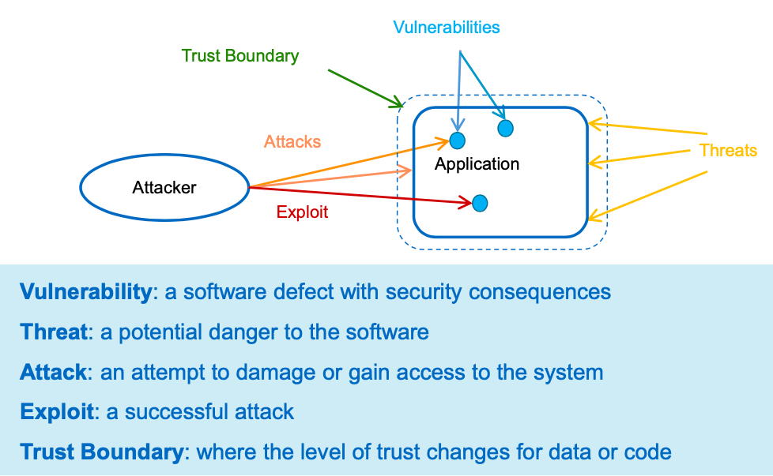

Slide 6
As regards risks, we adopt the definition according to the widely accepted standard ISO 27005:
“Threats abuse vulnerabilities of assets to generate harm for the organisation”. In more detailed terms, we consider risk as being composed of the following elements:

Slide 7
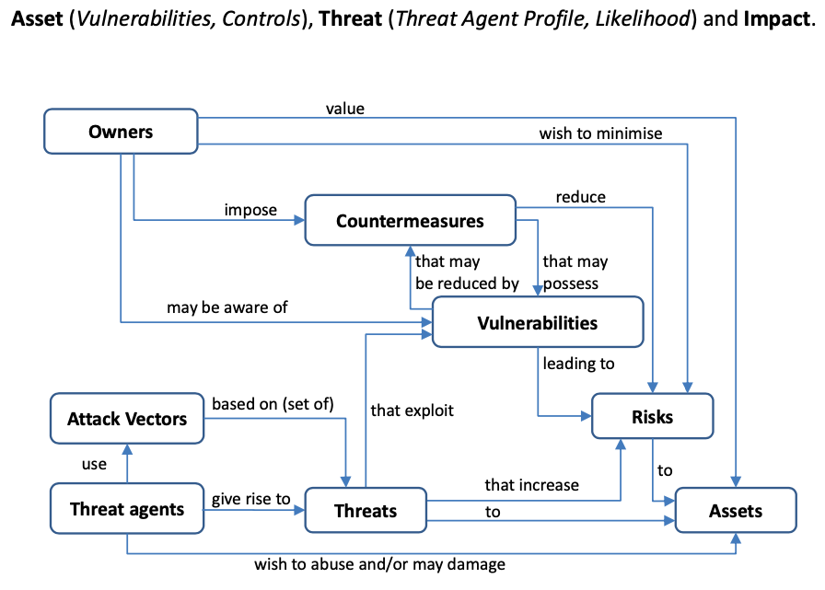

Slide 8
STANDARDISATION IN VULNERABILITY MODELLING
Common Vulnerabilities and Exposures (CVE),
Microsoft’s Security Bulletin (MS),
Seebug’s Vulnerability Database (SSV),
VMWare’s Security Advisory (VMSA).

Slide 9
Vulnerabilities kept private and not publicly disclosed are often referred to as “zero-day vulnerabilities”,
and the corresponding exploits are referred to as zero-day (0day) exploits.
At least 8.65% of the vulnerabilities are exploitable
Most exploits target web and client-side related vulnerabilities.
The top 10 weaknesses account for almost two thirds (64%) of the vulnerabilities.

Slide 10
Vulnerability lifecycle
Certain events in the lifetime of a vulnerability and the time periods between such events can be significant in the sense that they may influence the risk.
For example, there are normally delays in identifying vulnerability and disclosure.
There are also cyclic events associated with the battle between attacker exploitation and defensive code patching.
This overall chronology is referred to as the vulnerability lifecycle

Slide 11
The severity of the impact of a vulnerability is defined using the Common Vulnerability Scoring System (CVSS) maintained by the Forum of Incident Response and Security Teams (FIRST).
Vulnerabilities are associated with information technology systems and software packages; these can be categorised using the Common Platform Enumeration (CPE) database.
Exploits and Exploit Kits are developed to take advantage of the vulnerabilities. Exploitable vulnerabilities are usually based on software weaknesses.
Vulnerabilities can also be captured using CWETM (Common Weakness Enumeration): “a community-developed list of common software security weaknesses” and provides developers with advice on “prioritizing software weaknesses in a consistent, flexible, open manner”

Slide 12
Cyber kill chain
The cyber kill chain is a series of steps that trace stages of a cyberattack from the early reconnaissance stages to the exfiltration of data.
A comprehensive understanding of cyber-attacks and the Cyber kill chain (CKC) requires awareness of the vulnerability lifecycle including development of vulnerabilities into exploits.
The CKC also provides aspects of threat intelligence by assigning some attacker behaviours to specific events and uses model descriptions to comprehend those behaviours.
By modelling threats, the CKC helps determine severity of the attack and explains how they are enacted.

Slide 13
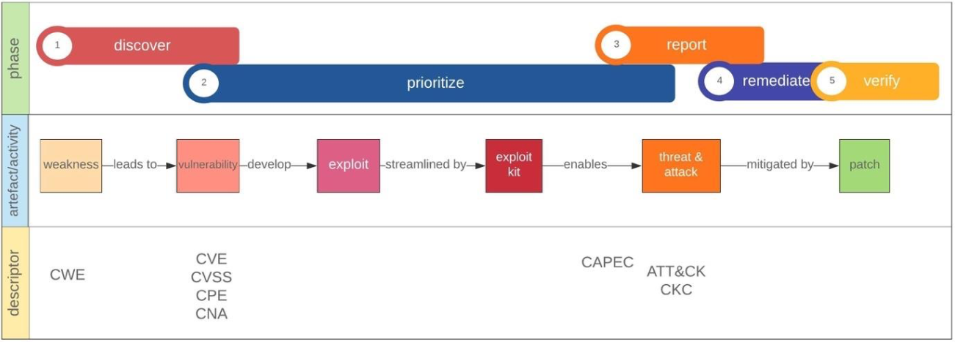
Vulnerability model context

Slide 14
Mapping the vulnerability lifecycle identifies significant milestones and events that define risk transitioning boundaries.
The significance of risks increases as vulnerabilities trigger the creation of the associated exploits and decrease when the patches become available.

Slide 15
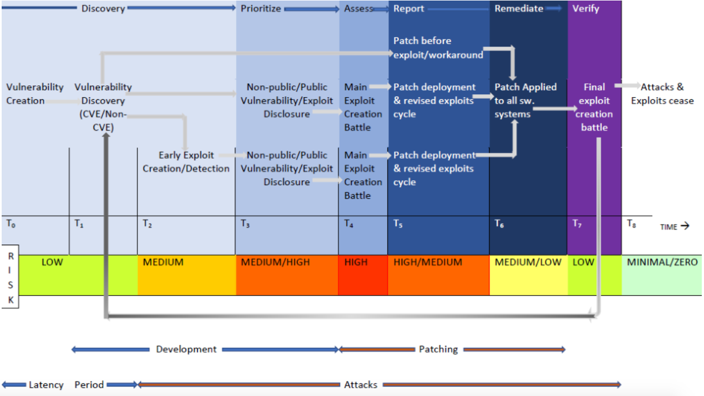
Vulnerability lifecycle

Slide 16
Example
Cisco IOS Arbitrary Command Execution Vulnerability (CVE-2012-0384)
Vulnerability
Cisco IOS 12.2 through 12.4 and 15.0 through 15.2 and IOS XE 2.1.x through 2.6.x and 3.1.xS before 3.1.2S, 3.2.xS through 3.4.xS before 3.4.2S, 3.5.xS before 3.5.1S, and 3.1.xSG and 3.2.xSG before 3.2.2SG, when AAA authorization is enabled, allow remote authenticated users to bypass intended access restrictions and execute commands via a (1) HTTP or (2) HTTPS session, aka Bug ID CSCtr91106.
Attack
The vulnerability allows an attacker to bypass command authorization restrictions assigned to their specific user account and execute commands that are available to the Roll/Privilege level for which the user is assigned. For example, a user that is in a group that is assigned to Privilege level 15 (admin) but was restricted to executing a single command via AAA (RADIUS/TACACS) could exploit the vulnerability to execute any other command available to an unrestricted admin user at Privilege level 15.

Slide 17
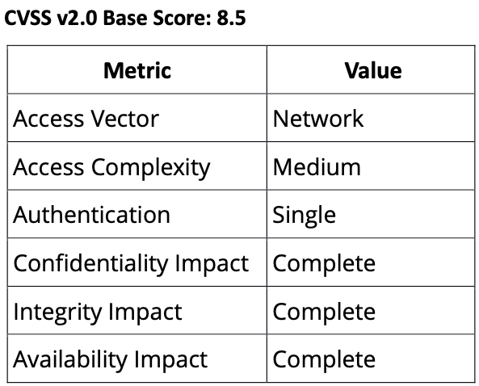
Example

Slide 18
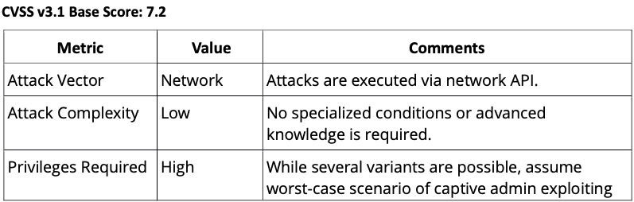
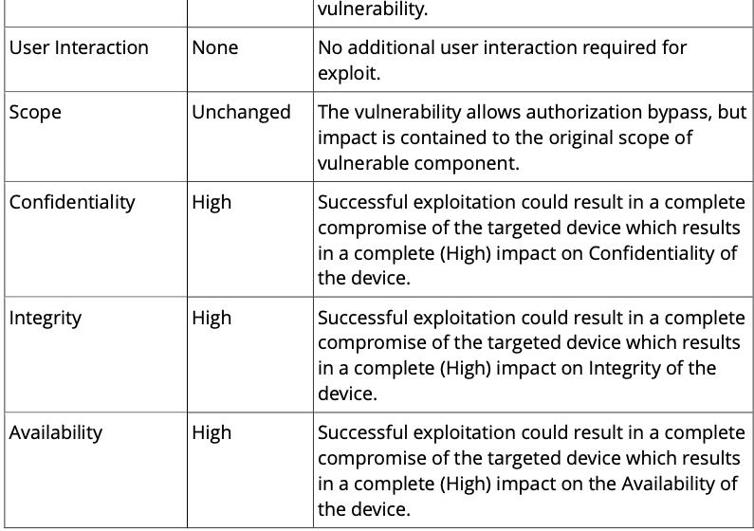

Slide 19
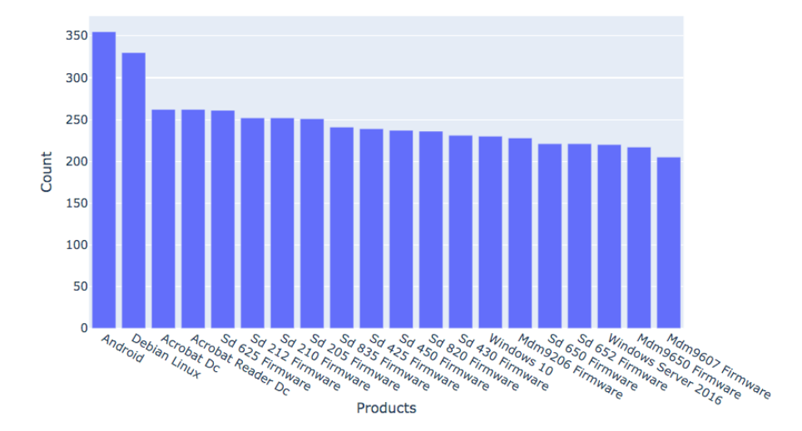
Top 20 products with the most CVEs (having score >=7)

Slide 20
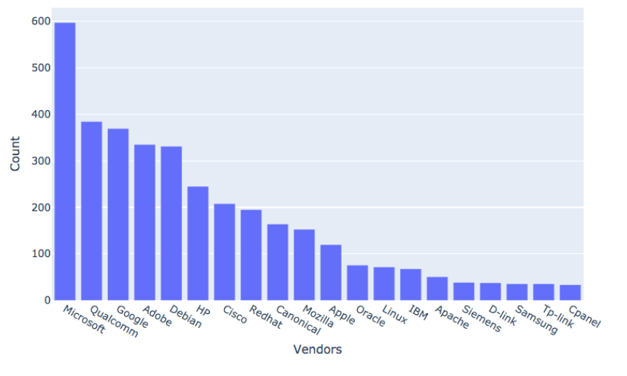
Top 20 vendors with the most CVEs (having score >=7)

Slide 21
Among the key milestone dates of a vulnerability is its actual publication date by which the vulnerability becomes widely known, and the publication of the exploit;
both these milestones normally put pressure to the vendor to come up with a security update.
In a relevant note, End of Support (EOS) date is the point in time where the vendor is not expected to develop a patch.

Slide 22
A pivotal moment in the life of a software product is when the vendor ceases to support it. From a security perspective this is critical as it stops issuing patch updates.
When vulnerabilities are reported to the vendor, it is expected that they would issue a patch within a certain timeframe. This timeframe should be subject to the severity of the vulnerability, however this is not observed.
Zero Day Initiative (ZDI) for example have a 120-day grace period. Following that, they disclose the vulnerability to the public, if the vendor does not issue any updates.

Slide 23
A threat actor can only succeed in an attack if they manage to develop and deploy an exploit against an existing vulnerability.
The existence of exploits and their characteristics (such as complexity, privileges required, and so forth) can significantly affect the level of risk. In this section the exploitation aspects of the vulnerability ecosystem are explored.

Slide 24
Bug bounty
The mobile operating systems are in the lead with Android having the higher maximum (outlier) value set to 2.5 million dollars. Although Google has paid since 2010 over $15m in total to researchers to date, the highest amount recorded in bug bounty programme is for bugs discovered for the Titan M chip used in Pixel smartphones, which may reach a maximum of $1.5m
In addition to the differentiation of prices based on the different systems, the bug bounty scheme notes high payouts for exploits delivering Local Privilege Escalation (LPE) and if done through Remote Code Execution. The highest payout which is for Android systems refers to a zero-click exploit, that is a 0day exploit that takes over an Android phone with no interaction from a user.

Slide 25
Threat source
Employees
Malicious intended
Ignorant
Non-employees
Outside attackers
Natural disasters

Slide 26
Attackers motives/goals
Disruption of Service
Expose sensitive information
Alter information
Damage information
Delete information
Jokes
Publicity, peer recognition
Monetary gain
Revenge/Defaming others
Political means
Terrorism
Curiosity, testing skills/system

Slide 27
Attack methods
Social Engineering
Malware
Key-loggers
Exploitation of vulnerabilities
Packet modification/replay
IP spoofing
Various hacking tools
Password cracking
Cross-site scripting
SQL injection

Slide 28
Classification of threats
Transmission Threats
Eavesdropping/Sniffer
DoS/DDoS
Covert channel
Spoofing
Tunneling
Masquerading/man-in-the middle attacks
Physical Threats
Physical access
Sppying

Slide 29
Classification of threats
Malicious Code Threats
Virus
SQL Injection
Cross-site Scripting
Worms
Trojans
Spyware/Adware
Logic Bombs
Backdoors
Bots
Application Threats
Buffer overflows
SQL Injection
Cross-site Scripting

Slide 30
Classification of threats
Social engineering
Dumpster diving
Impersonation
Shoulder surfing
Improper usage/Unauthorized access
Hackers
Greyhats, Whitehats, Black hats
Internal intruders
Defacement
Spam
Phishing

Slide 31
Threat Modeling is a process that helps:
– Accurately determine the attack surface for the application – Assign risk to the various threats
– Drive the vulnerability mitigation process
It is widely considered to be the one best method of improving the security

Slide 32
Threat Models
A model is a simplified representation of something else. A model ignores, masks, or abstracts unimportant or unnecessary details, thereby highlighting the details of interest.
A threat model highlights the details of interest regarding a threat, class of threat, or threats in general
A threat model will generally address both a threat capabilities and its intent. Basically, threat modeling is a structured approach that allows cyber security threats to be identified in terms of objectives and vulnerabilities, as well as identifying appropriate countermeasures to prevent, or mitigate the effects of, threats to the system.

Slide 33
There are at least three general approaches to threat modelling:
Attacker-centric;
System-centric;
Asset-centric.

Slide 34
Common Language Security Incident Taxonomy
Event - an action directed at a target which is intended to result in a change of state (status) of the target;
Attack - a series of steps taken by an attacker to achieve an unauthorized result. The first two steps in an attack, tool and vulnerability, are used to cause an event on a computer or network.
Incident - a group of attacks that can be distinguished from other attacks because of the distinctiveness of the attackers, attacks, objectives, sites, and timing;
Attacker – an individual who attempts one or more attacks i n order to achieve an objective;

Slide 35
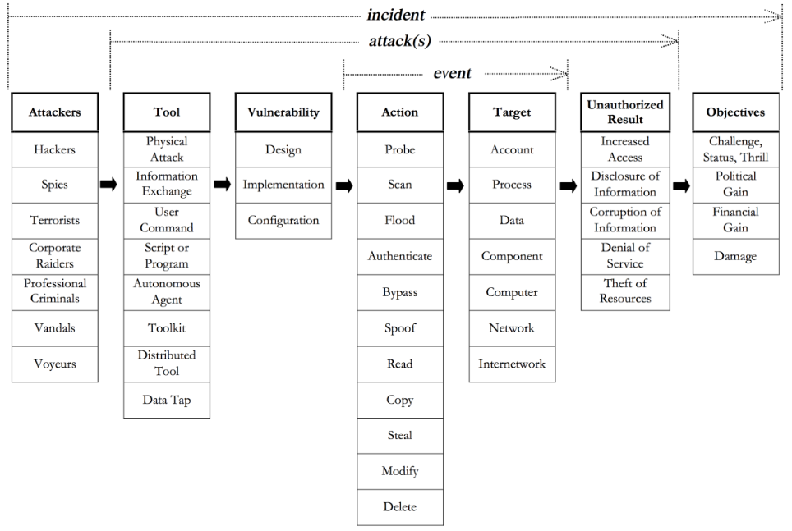

Slide 36
Threat Attributes & Profile
A threat attribute is a discrete characteristic, or distinguishing property, of a threat. The combined characteristics of a threat describe the threat’s willingness and ability to pursue its goal.
Intensity - The threat attribute of Intensity describes the diligence, or persevering determination, of a threat in the pursuit of its goal.
Stealth - The threat attribute of Stealth describes the abilityof the threat to maintain a necessary level of secrecy throughout the pursuit of its goal.
Time - The threat attribute of Time quantifies the period of ti me that a threat is capable of dedicating to planning, developing, and deploying methods to reach an objective.

Slide 37
Threat Attributes & Profile
Personnel - The threat attribute of Technical Personnel quantifies the number of group members that a threat is capable of dedicating to the building and deployment of the technical capability in pursuit of its goal.
Knowledge -The threat attribute of Knowledge defines the threat’s level of theoretical and practical proficiency and the threat’s capability of employing that proficiency in pursuit of its goal.
Access - The threat attribute of Access defines a threat’s ability to place a group member within a restricted system—whether through cyber or kinetic means—in pursuit of the threat’s goal.

Slide 38
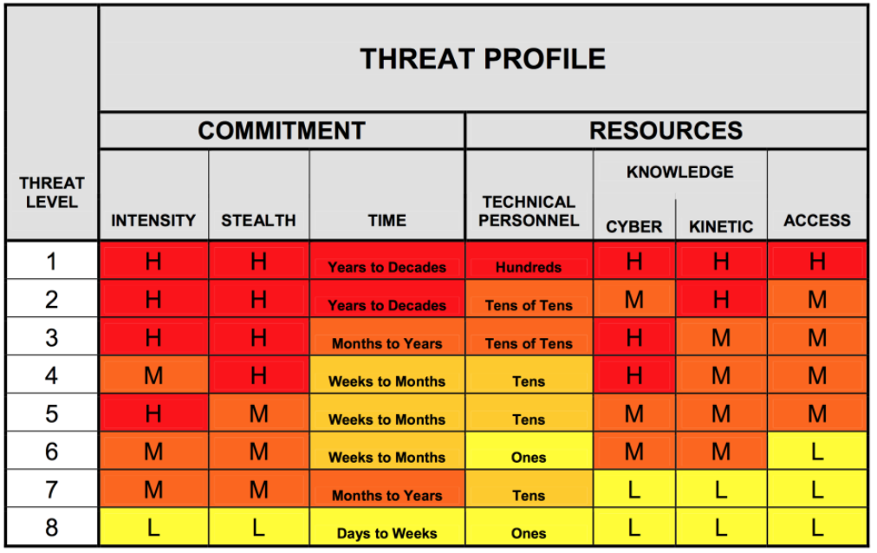

Slide 39
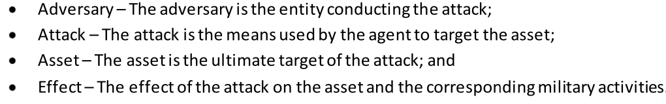
Threat Characterization Framework

Slide 40
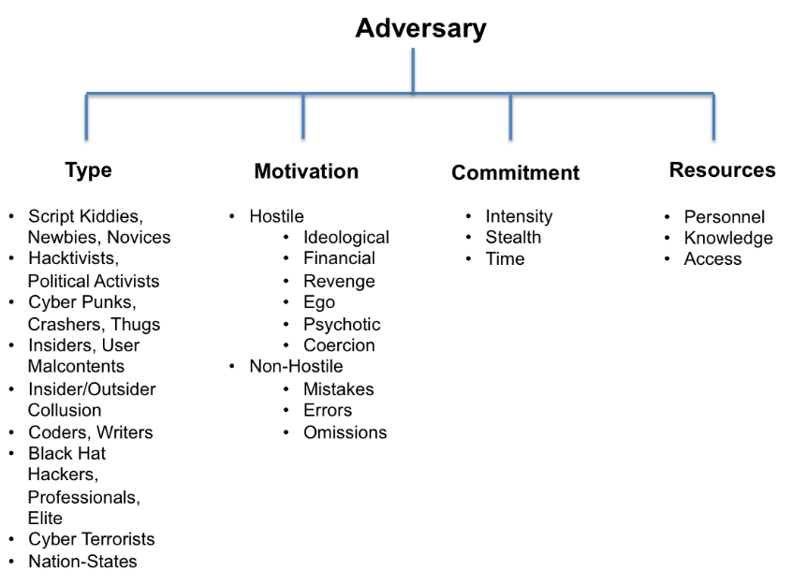

Slide 41
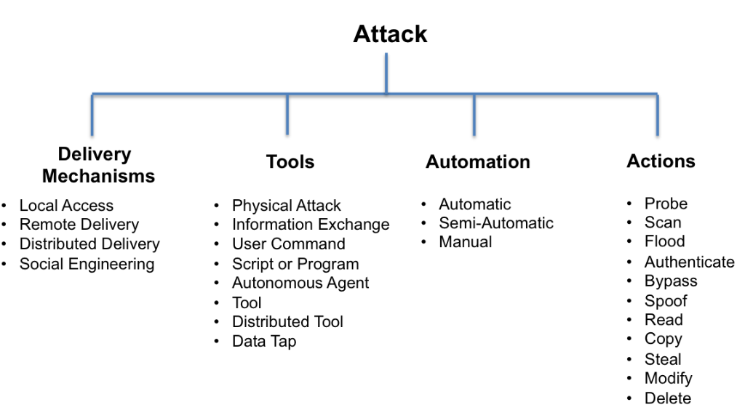

Slide 42
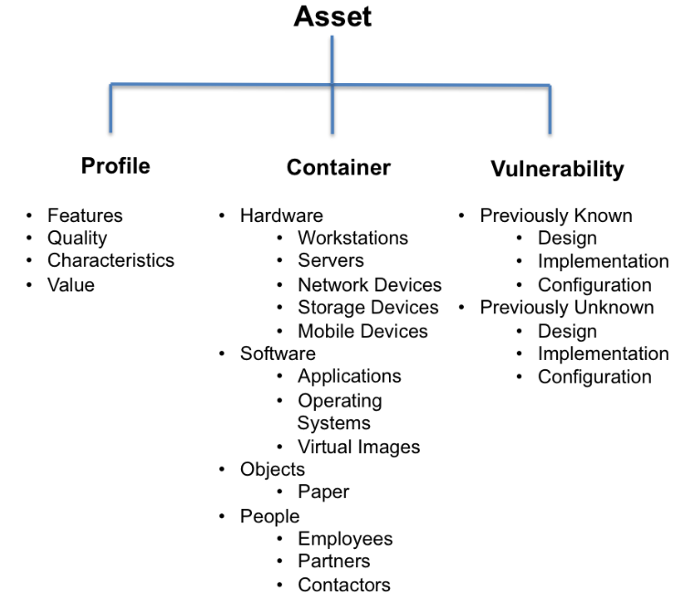

Slide 43
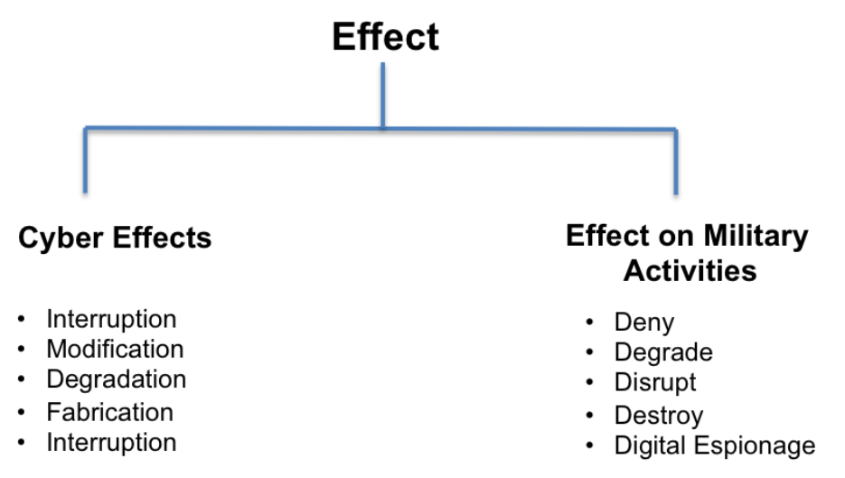

Slide 44
STRIDE Threat analysis

Slide 45
STRIDE categorizes threats into six types:
Spoofing threats: a process or an interactor pretends to be someone/thing else.
Tampering threats: a process, a data flow, or a datastore is changed.
Repudiation threats: evidence of an action by a process or an interactor disappears.
Information disclosure threats: a process, a dataflow, or a datastore reveals sensitive data.
Denial of service threats: a data flow, a datastore, or a process is overloaded, rendering normal use impossible.
Elevation of privilege threats: a process is used to perform unauthorized actions.

Slide 46
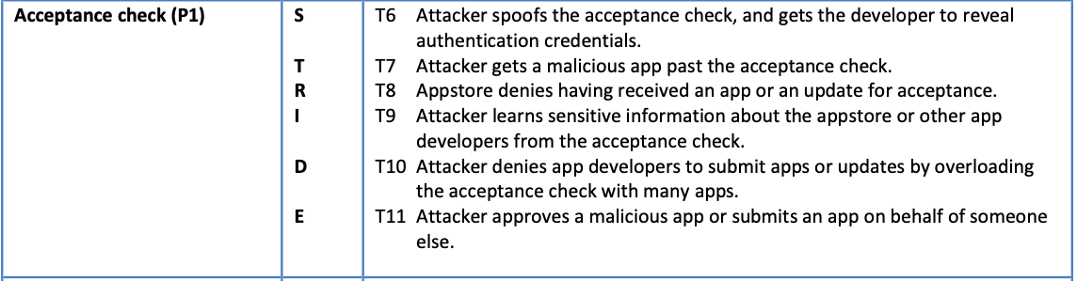
Example

Slide 47
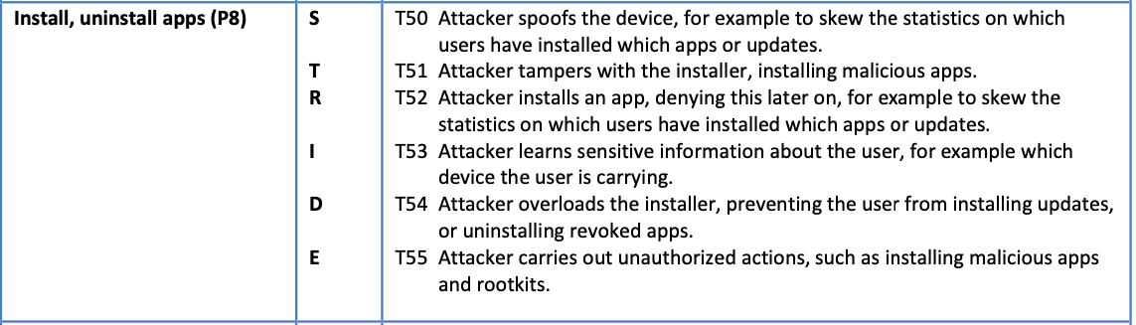
Example

Slide 48
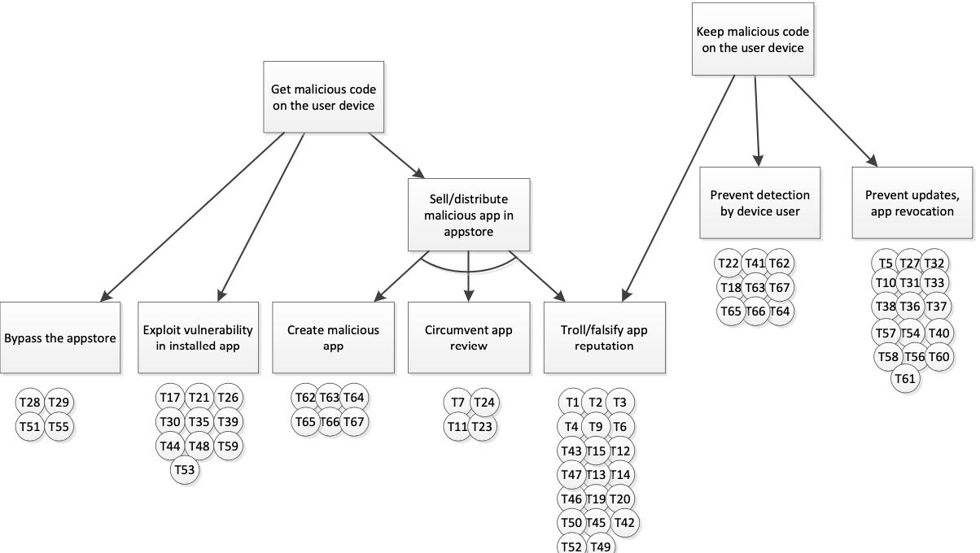
Attack tree

Slide 49
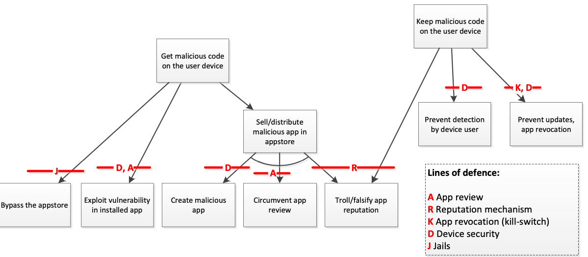
Lines of defence

Slide 50
Addressing Threats
Mitigating threats is about doing things to make it harder to take advantage of a threat. Requiring passwords to control who can log in mitigates the threat of spoofing. Adding password controls that enforce complexity or expiration makes it less likely that a password will be guessed or usable if stolen.
Eliminating threats is almost always achieved by eliminating features. If you have a threat that someone will access the administrative function of a website by visiting the /admin/URL, you can mitigate it with passwords or other authentication techniques, but the threat is still present. You can eliminate it by removing the interface, handling administration through the command line.

Slide 51
Addressing Threats
Transferring threats is about letting someone or something else handle the risk. For example, you could pass authentication threats to the operating system, or trust boundary enforcement to a firewall product.
Accepting the risk is the final approach to addressing threats. For most organizations most of the time, searching everyone on the way in and out of the building is not worth the expense or the cost to the dignity and job satisfaction of those workers. Similarly, the cost of preventing someone from inserting a back door in the motherboard is expensive, so for each of these examples you might choose to accept the risk.

Slide 52
Abbreviations
CKC - Cyber Kill Chain
CWE - Common Weakness Enumeration
CWSS - Common Weakness Scoring System
CAPEC - Common Attack Pattern Enumeration and Classification
CPE - Common Platform Enumeration
CVSS - Common Vulnerability Scoring System
CVE - Common Vulnerabilities and Exposures

Slide 53
References:
- Stilianos Vidalis, Andrew Jones, Analyzing Threat Agents and Their Attributes, Research Group Leader, BT Group, 2005.
- Timothy Casey, Threat Agent Library Helps Identify Information Security Risks, White Paper, Intel Information Technology, 2007.
- A.Shostack, Threat Modelling, Wiley.
- MITRE ATT&CK: https://attack.mitre.org
- Common Vulnerabilities and Exposures: https://cve.mitre.org
- National Vulnerability Database: https://nvd.nist.gov/general
- Zerodium: https://zerodium.com
- Exploits Kits: https://www.trendmicro.com/vinfo/us/security/definition/exploit-kit

